Slide 1

revision history

Slide 2
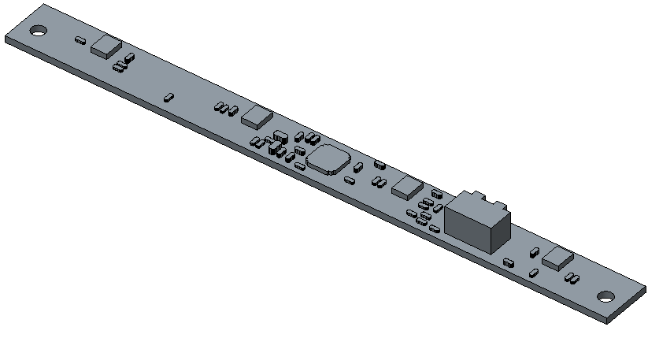
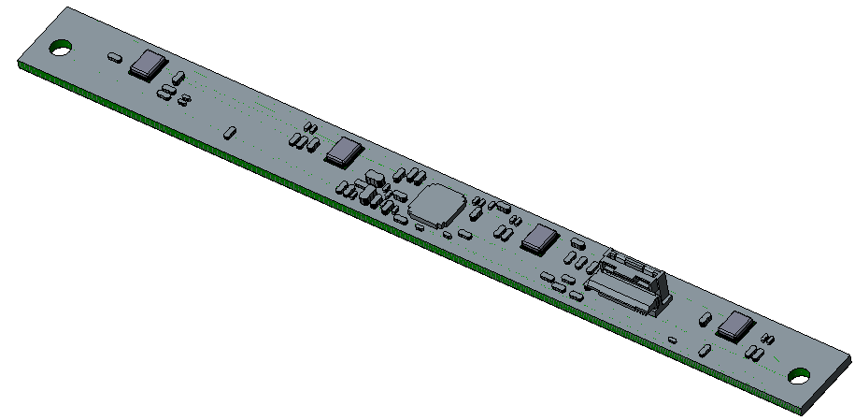
MIC Board
DVT data
actual DVT build

Slide 3
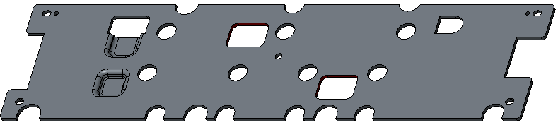
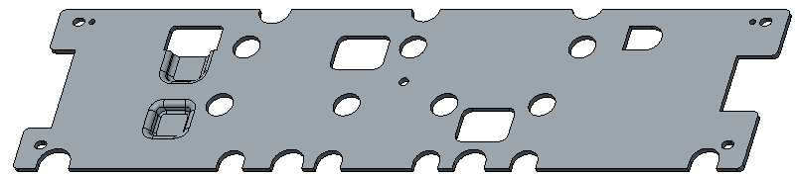
HEATSPREADER_AMP_BOTTOM_ASSY
DVT data
actual DVT build

Slide 4

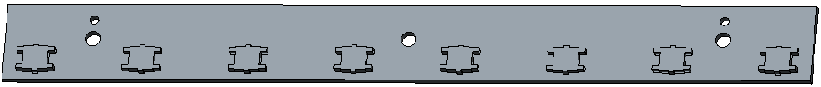

BUTTON_PCB_ASSY
Change the direction of connector
DVT data
actual DVT build

Slide 5
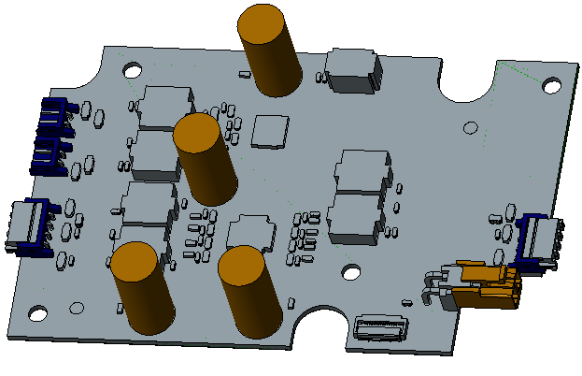
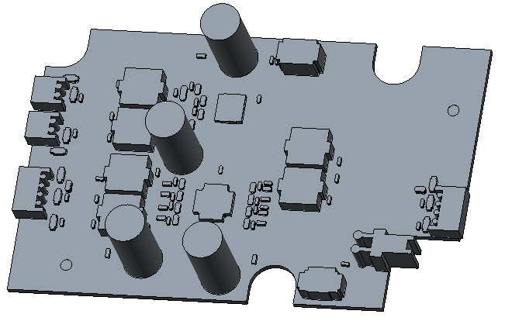
Amp Board
DVT data
actual DVT build

Slide 6
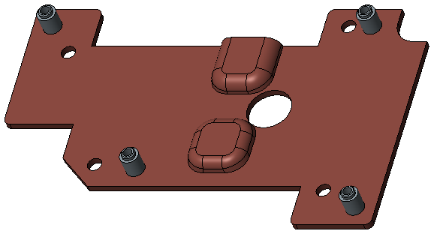
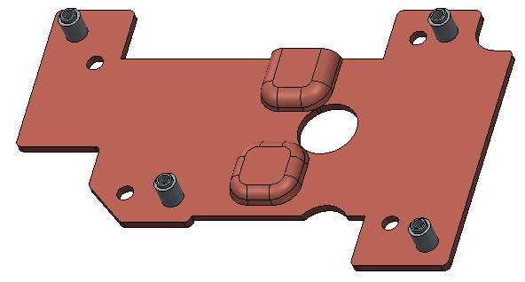
HEATSPREADER_AMP_TOP_ASSY
DVT data
actual DVT build

Slide 7
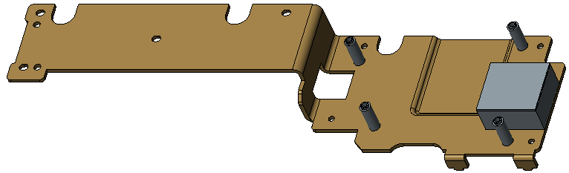
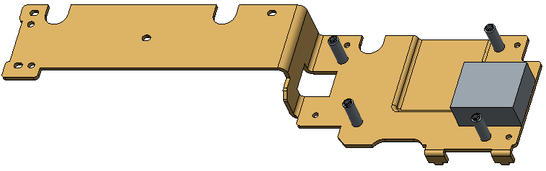
HEATSPREADER_TOP_SOC_ASSY
DVT data
actual DVT build

Slide 8
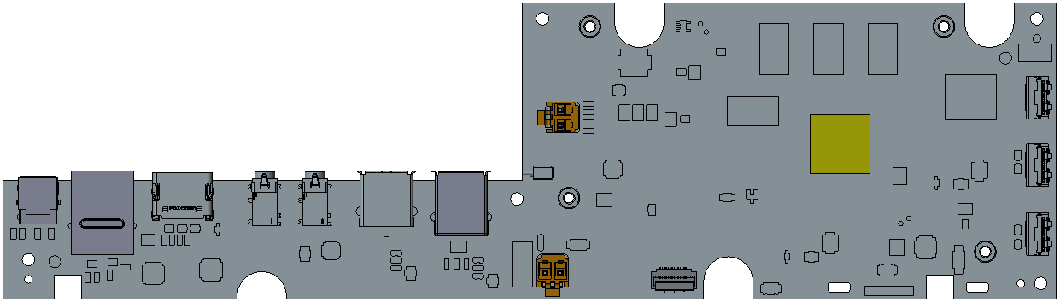
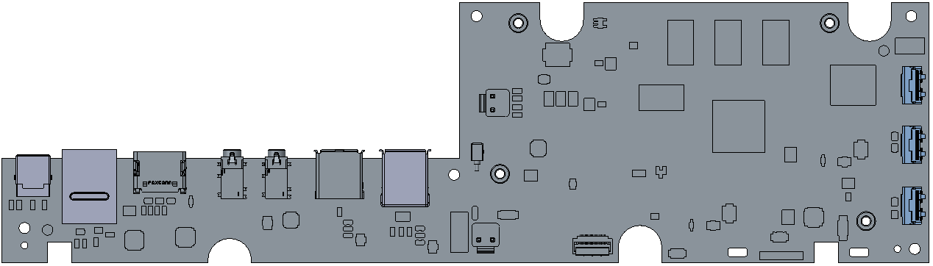
SWAN_PCB_ASSY
DVT data
actual DVT build

Slide 9
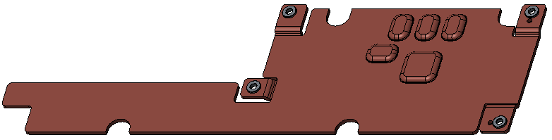
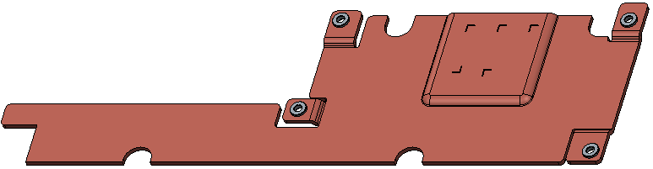
HEATSPREADER_BTTOM_SOC_ASSY
Change the bump
DVT data
actual DVT build

